Slide 1
PINNs

Slide 2
PINN for differential equations
Logistic equation with carrying capacity > 1
Regular perturbation with analytical solution > 1
Singular perturbation with single boundary layer

Slide 3
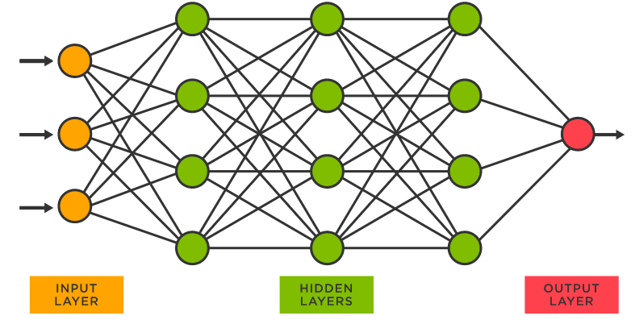
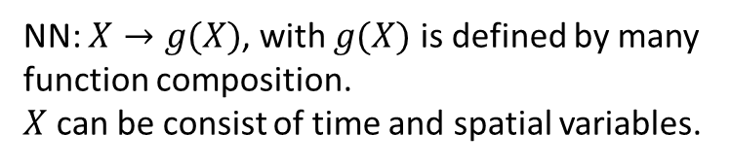


NN architecture
Hidden layer: 5
Neuron per hidden layer: 50
NN: $X→g(X)$, with $g(X)$ is defined by many function composition.
$X$ can be consist of time and spatial variables.
$$X→z_{1}=W_{1}X+b_{1}→a_{1}=f\left(z_{1}\right)→$$
$$z_{2}=W_{2}a_{1}+b_{2}→a_{2}=f\left(z_{2}\right)→$$
$$…$$
$$→z_{n}=W_{n}a_{n−1}+b_{n}→u=f(z_{n})$$
$X$: input
$u$: output
$W_{i},b_{i}$: weight and bias
$f$: activation function

Slide 4
Logistic equation with carrying capacity > 1
Problem:
Tanh activation function cannot approximate the solution accurately.
Proposed solution: Using custom activation function. For example: 2*tanh(x).
Cons: Pytorch doesn’t support custom activation function.
Another solution: Try all available built-in activation function.

Slide 5
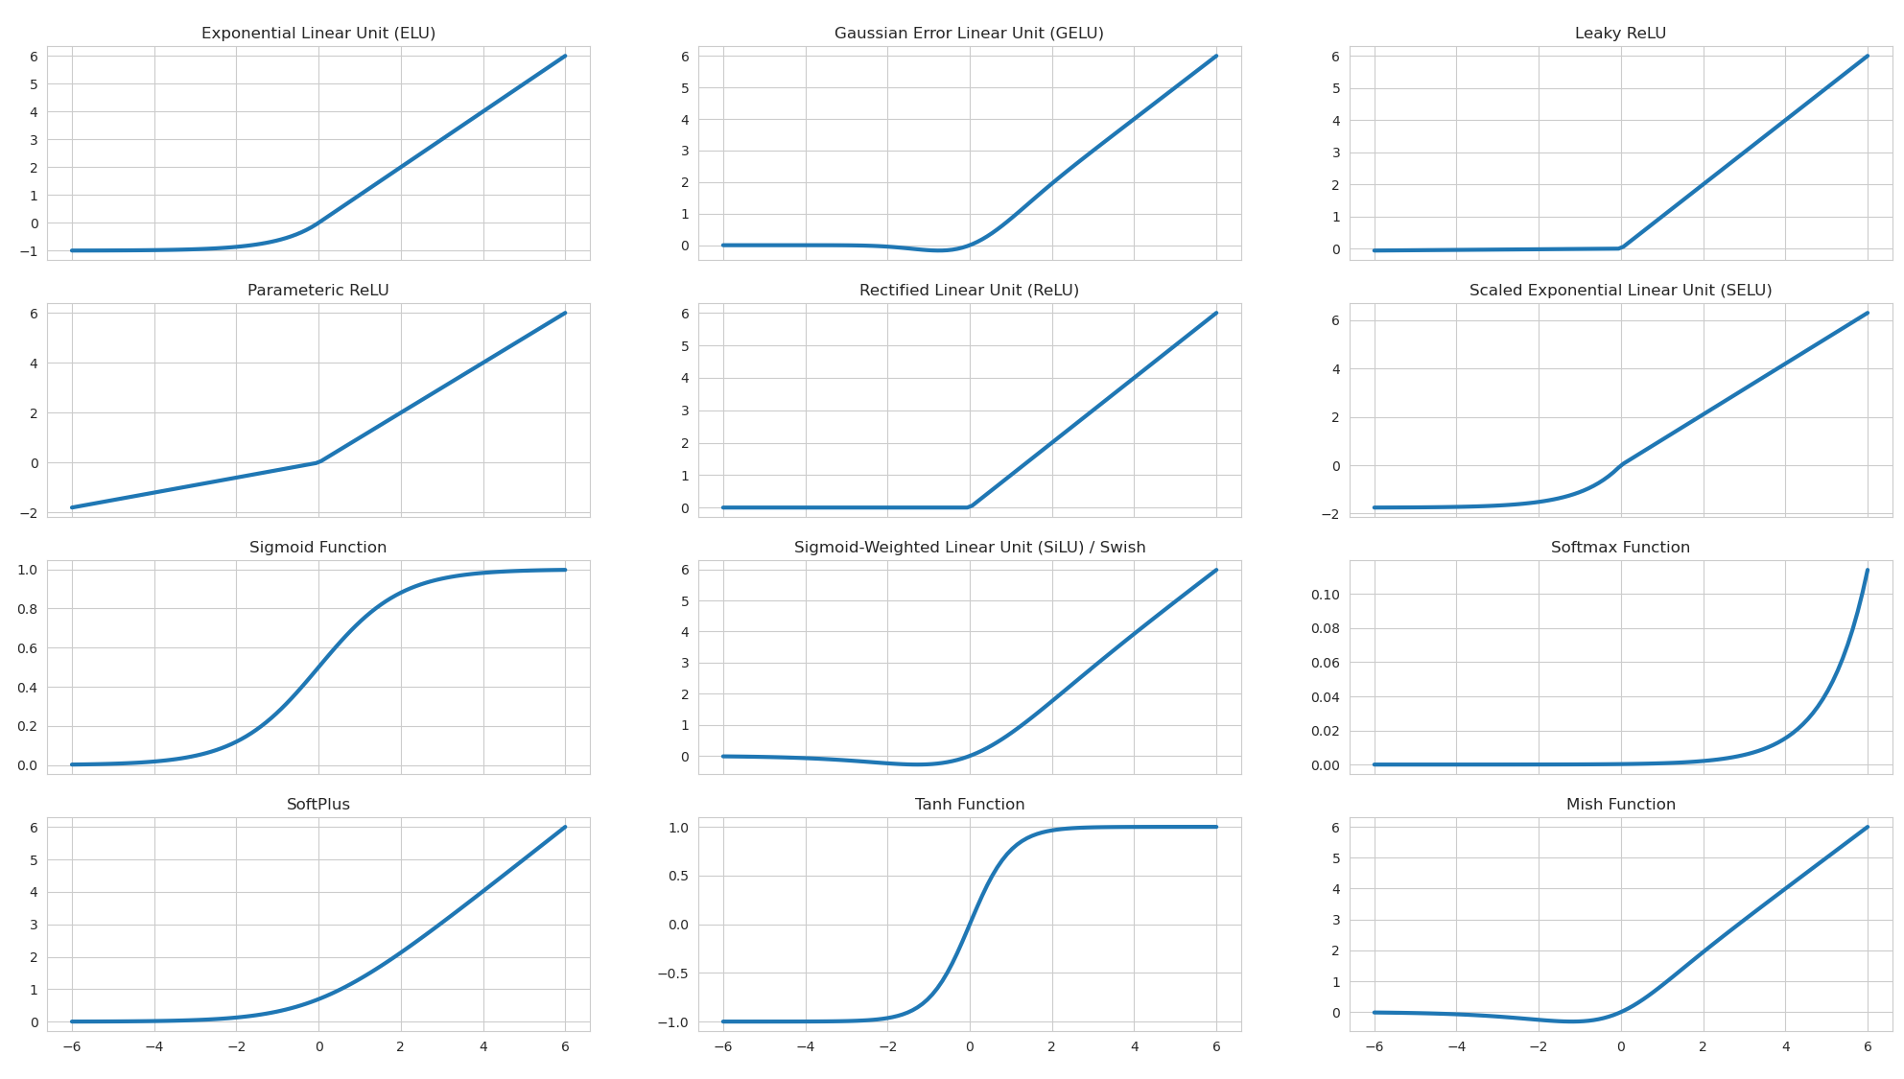

Slide 6
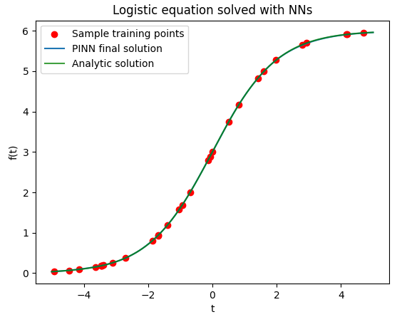
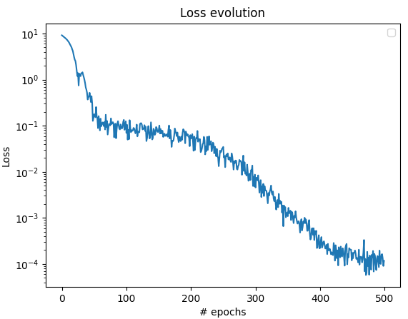

Logistic equation with carrying capacity > 1
$$y^{′}=ky\left(1−\frac{y}{L}\right)$$
$$y\left(0\right)=3$$

Slide 7
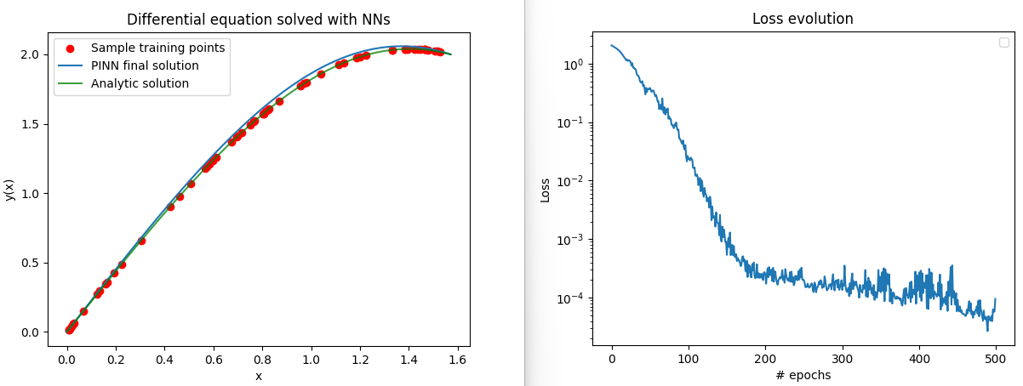

Regular perturbation with analytical solution > 1
Activation Function | Error
ReLU | 0.22135618329048157
Tanh | 0.0002235374558949843
Sigmoid | 0.13676562905311584
SiLU | 0.0001053984306054189
Mish | 9.546917863190174e-05
ELU(alpha=1.0) | 0.04276195168495178
CELU(alpha=1.0) | 0.005296417977660894
SELU | 0.019998017698526382
GELU | 0.0003031024825759232
LeakyReLU(negative_slope=0.01) | 0.04575829580426216
Softplus(beta=1, threshold=20) | 0.0002291699202032759
$${y"+y+εy}^{3}=0$$
$$y\left(0\right)=0,y\left(\frac{π}{2}\right)=2$$
With $ε=0.1$

Slide 8
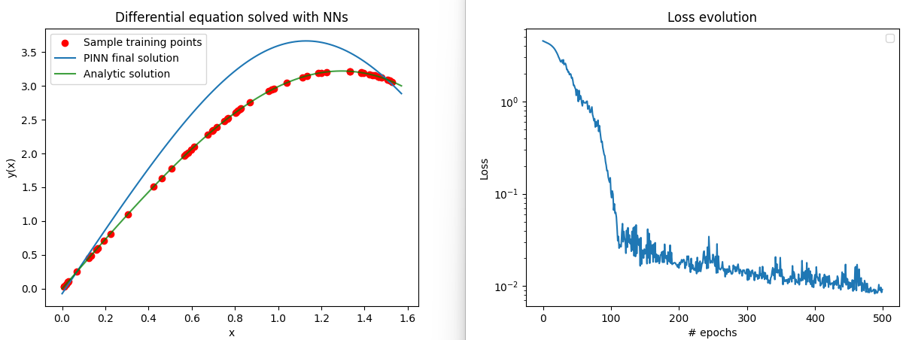

Regular perturbation with analytical solution > 1
Activation Function | Error
ReLU | 0.624647319316864
Tanh | 0.016949603334069252
Sigmoid | 0.5736966133117676
SiLU | 0.009206760674715042
Mish | 0.01047955360263586
ELU(alpha=1.0) | 0.31320619583129883
CELU(alpha=1.0) | 0.08923442661762238
SELU | 0.048574574291706085
GELU | 0.023113004863262177
LeakyReLU(negative_slope=0.01) | 0.07233785092830658
Softplus(beta=1, threshold=20) | 0.013135198503732681
Softmin | 3.4358506202697754
Softmax | 3.430147171020508
$${y"+y+εy}^{3}=0$$
$$u"+(π/2)^2 u + ε(π/2)^2 ×9u=0$$
$$u\left(0\right)=0,u\left(1\right)=1$$
$$y\left(0\right)=0,y\left(\frac{π}{2}\right)=3$$
With $ε=0.1$

Slide 9
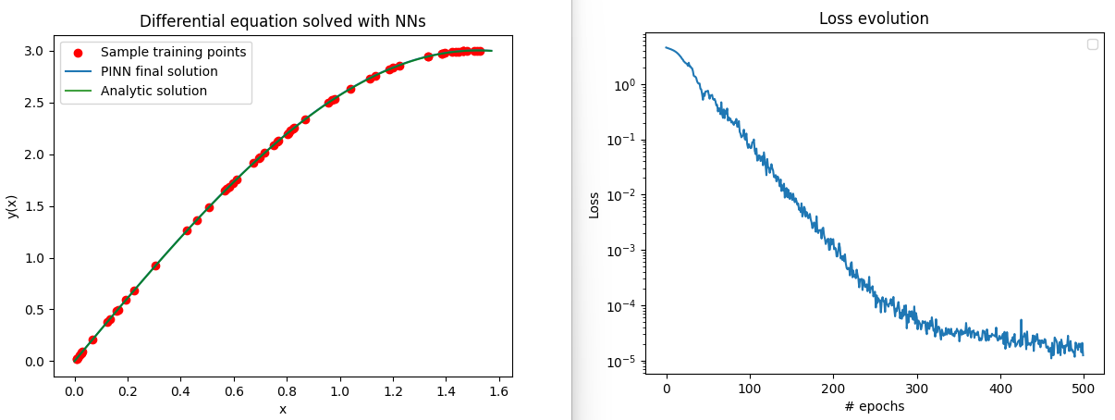

Regular perturbation with analytical solution > 1
Activation Function | Error
ReLU | 0.31772175431251526
Tanh | 0.0002926215820480138
Sigmoid | 0.13228343427181244
SiLU | 0.0001527002750663086
Mish | 1.2443665582395624e-05
ELU(alpha=1.0) | 0.01950571872293949
CELU(alpha=1.0) | 0.008640305139124393
SELU | 0.007875306531786919
GELU | 0.0001140611057053320
LeakyReLU(negative_slope=0.01) | 0.2192445695400238
Softplus(beta=1, threshold=20) | 0.0002091066126013174
Softmin | 3.3970866203308105
Softmax | 3.3861441612243652
$${y"+y+εy}^{3}=0$$
$$y\left(0\right)=0,y\left(\frac{π}{2}\right)=3$$
With $ε=0.01$

Slide 10
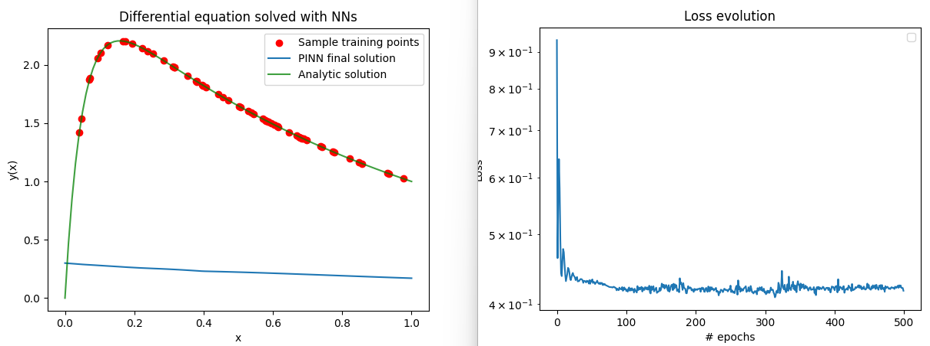

Singular perturbation with single boundary layer
Activation Function | Error
ReLU | 0.42823082208633423
Tanh | 0.42543718218803406
Sigmoid | 0.4407207667827606
SiLU | 0.4247911274433136
Mish | Failed
ELU(alpha=1.0) | 0.4248681664466858
CELU(alpha=1.0) | 0.4254888594150543
SELU | 0.4173770546913147
GELU | 0.42677149176597595
LeakyReLU(negative_slope=0.01) | 0.427365243434906
Softplus(beta=1, threshold=20) | 0.4247998893260956
Softmin | 0.45000001788139343
Softmax | 0.44999995827674866
$$εy"+2y′+2y=0$$
$$y\left(0\right)=0,y\left(1\right)=1$$

Slide 11
Singular perturbation with single boundary layer
Problems: no built-in activation function can approximate solution of boundary layer problem accurately.
Proposed solution: using non-homogenous collocation points -> very dense around boundary layer.

Slide 12
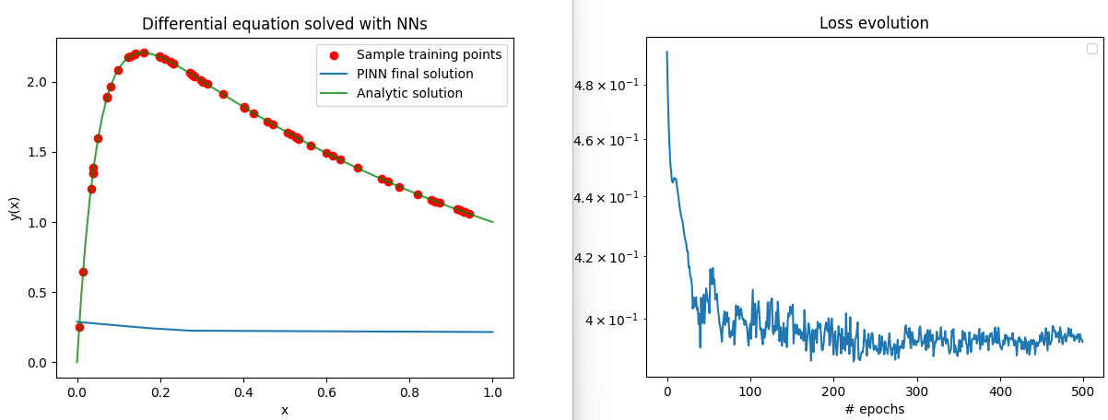
Result of proposed solution
Activation Function | Error
ReLU | 0.41714686155319214
Tanh | 0.39535191655158997
Sigmoid | 0.39696067571640015
SiLU | 0.40223413705825806
Mish | Failed
ELU(alpha=1.0) | 0.39985793828964233
CELU(alpha=1.0) | 0.40406373143196106
SELU | 0.4046385884284973
GELU | 0.395433247089386
LeakyReLU(negative_slope=0.01) | 0.39293965697288513
Softplus(beta=1, threshold=20) | 0.39850521087646484
Softmin | 0.45000001788139343
Softmax | 0.44999995827674866

Slide 13
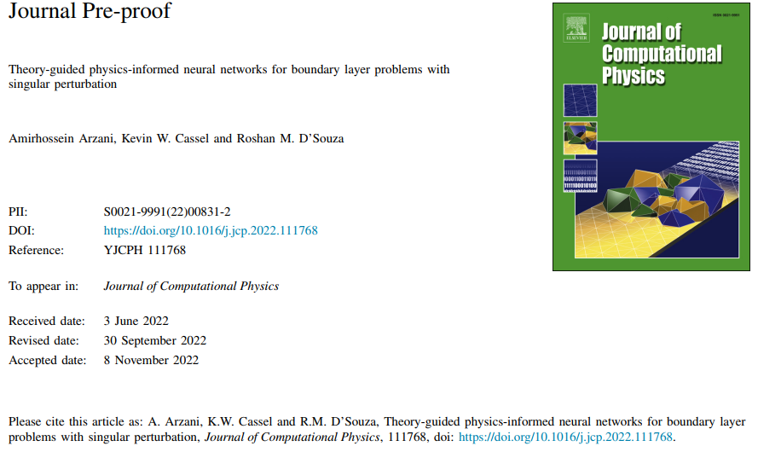

Slide 14
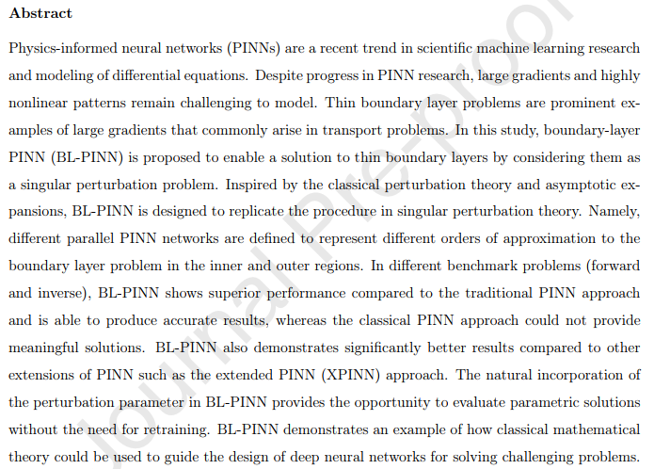
Theory-guided physics-informed neural networks for boundary layer problems with singular perturbation. (Arzani, 2022)

Slide 15
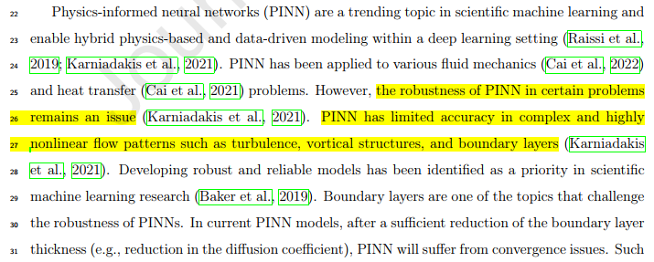
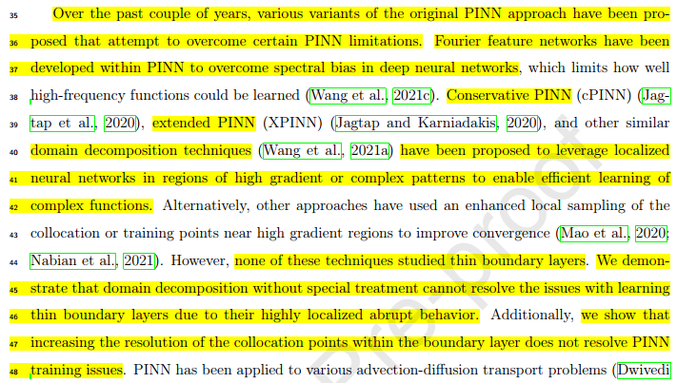

Slide 16
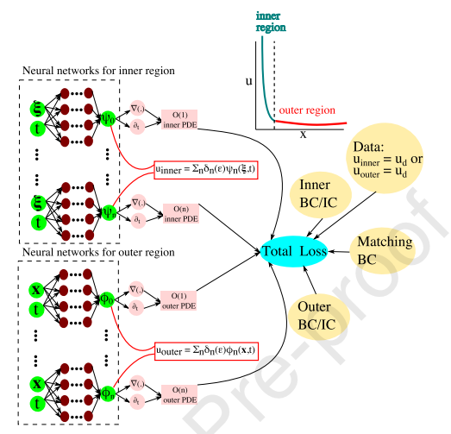

Slide 17
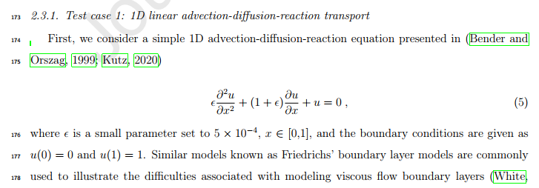
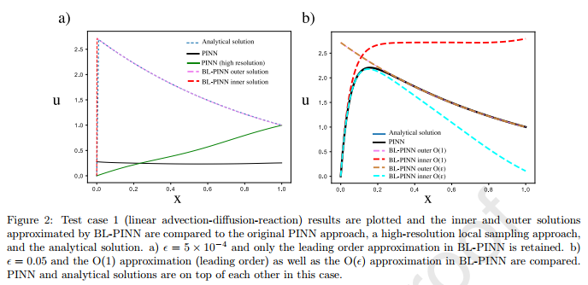
Test-case 1

Slide 18

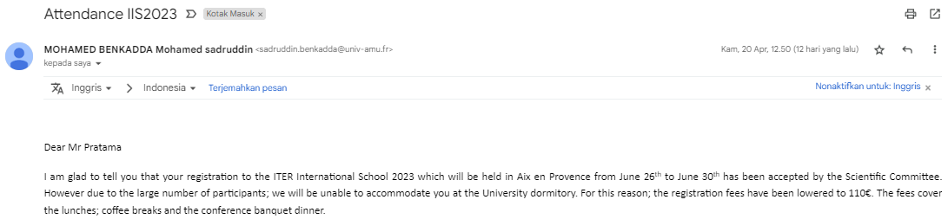
https://iis2023.sciencesconf.org/

Slide 19

https://seams-ugm.id/2023/ Exploring modified-pinn method to some ODE perturbation problems

